Slide 1
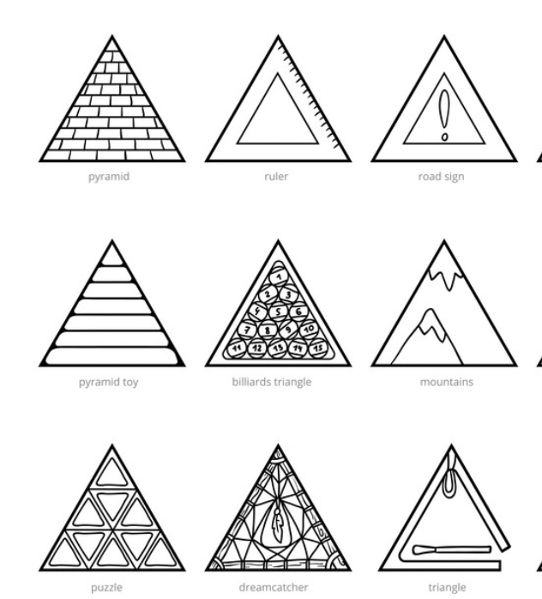

MACHINE LEARNING …!
TOPICS
INTRODUCTION
DATA VISUALISATION
DATA PREPROCESSING
MODEL CREATION
ACCURACY PREDICTION
MODEL COMPARISON

Slide 2
PROBLEM STATEMENT AND DESCRIPTION OF DATASET
WE ARE GIVEN WITH THE DATASET USING WHICH THE MACHINE LEARNING MODEL PREDICTS WHETHER A PERSON CLICKS ON A PARTICULAR ADD OR NOT
SO THERE ARE 10 COLOUMNS AND 1000 ROWS IN THE DATASET , THE LABEL IS “CLICK ON AD”
THE DATA IN THE DATASET IS NOT SKEWED , IT IS KIND OF UNIFORMLY DISTRIBUTED
COLOUMNS/ATTRIBUTES ARE NOMINAL/ORDINAL IN THIS DATASET

Slide 3
LIBRARIES USED
NUMPY
PANDAS
SEABORN
MATPLOTLIB
SKLEARN

Slide 4
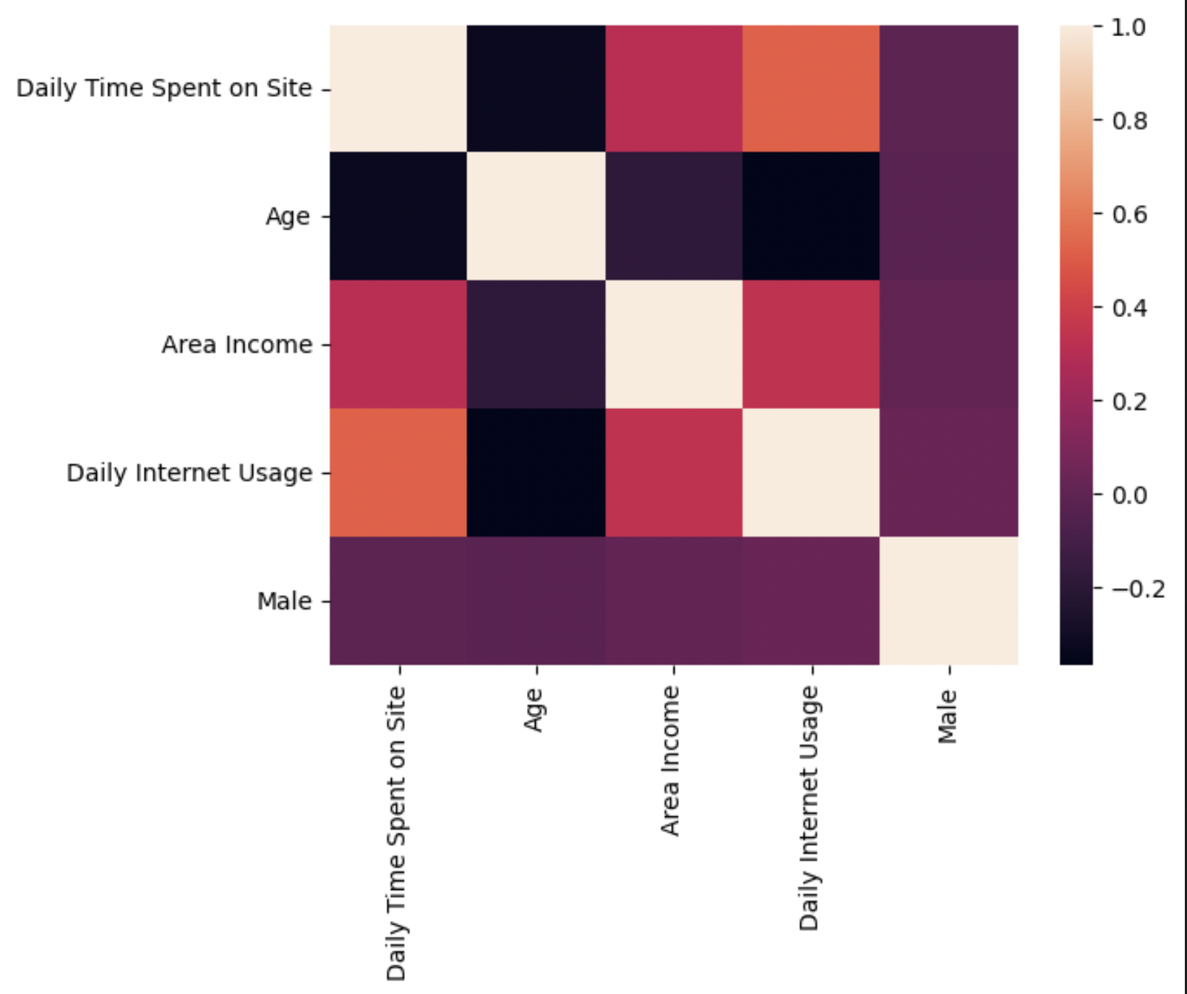
DATA VISUALISATION
IN ORDER TO UNDERSTAND THE DATASET BEFORE FEEDING OIT TO THE MODEL , WE WILL SEE SOME VISUALISATIONS OF THE DATA
HEAT MAP
A METHOD TO IDENTIFY STRONGLY CORRELATED COLUMNS ,AND REMOVE THEM TO REDUCE THE DIMENSIONS OF THE INPUT
WE KNOW THAT AS INPUT SIZE INCREASES COMPLEXITY OF PREDICTING THE LABEL ALSO INCREASES
THIS IS TERMED TO BE “DIMENSIONALITY REDUCTION”

Slide 5
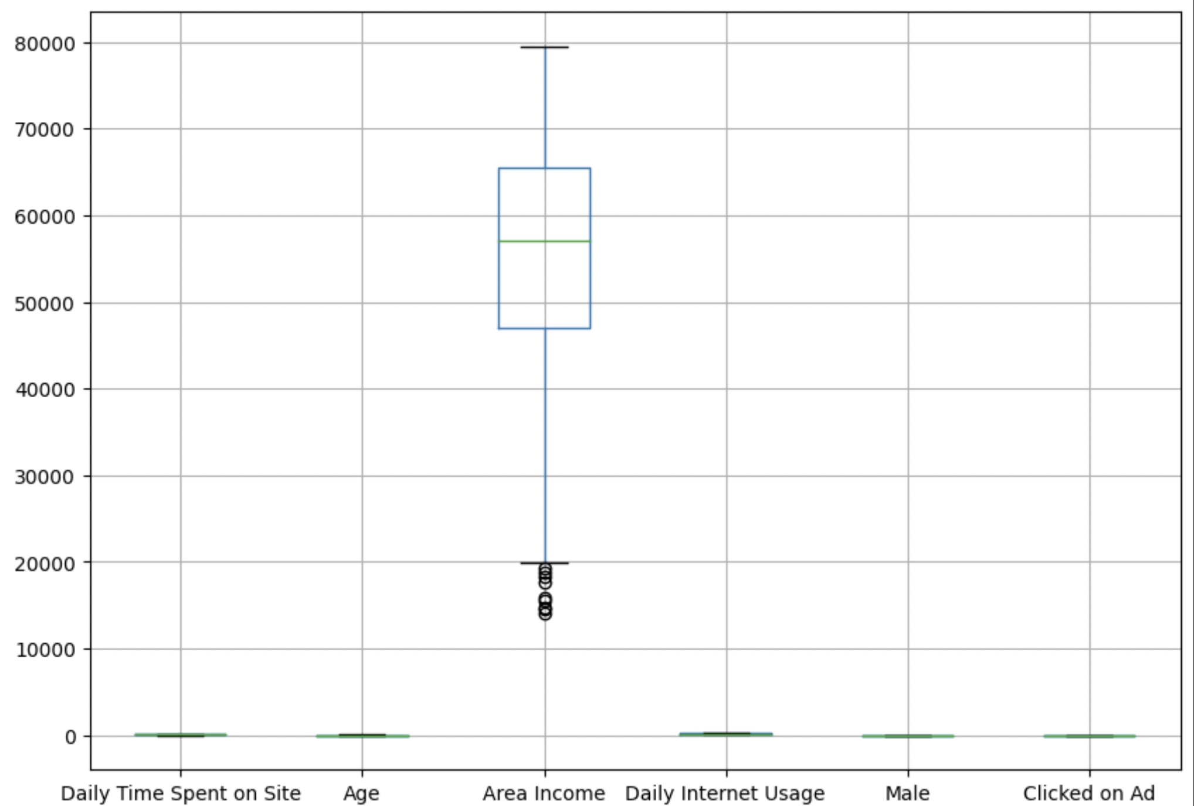
DATA VISUALISATION
BOX PLOT
BOX PLOT GENERALLY HELPS IN PREDICTING OUTLIERS , WHICH ARE GENERALLY NOISES WHICH REDUCE THE ACCURACY OF PREDICTION OF LABEL.
BOX PLOT DEPICTS MINIMUM VALUE, MAXIMUM VALUE, FIRST QUARTILE , THIRD QUARTILE , MEDIAN VALUE AND OUTLIERS(DOTS)
THE ABOVE QUANTITIES ARE GENERALLY NAMED AS “FIVE POINT SUMMARY” OF DATA
BOX PLOT CAN BE DRAWN FOR ATTRIBUTES WITH NUMERICAL VALUES

Slide 6
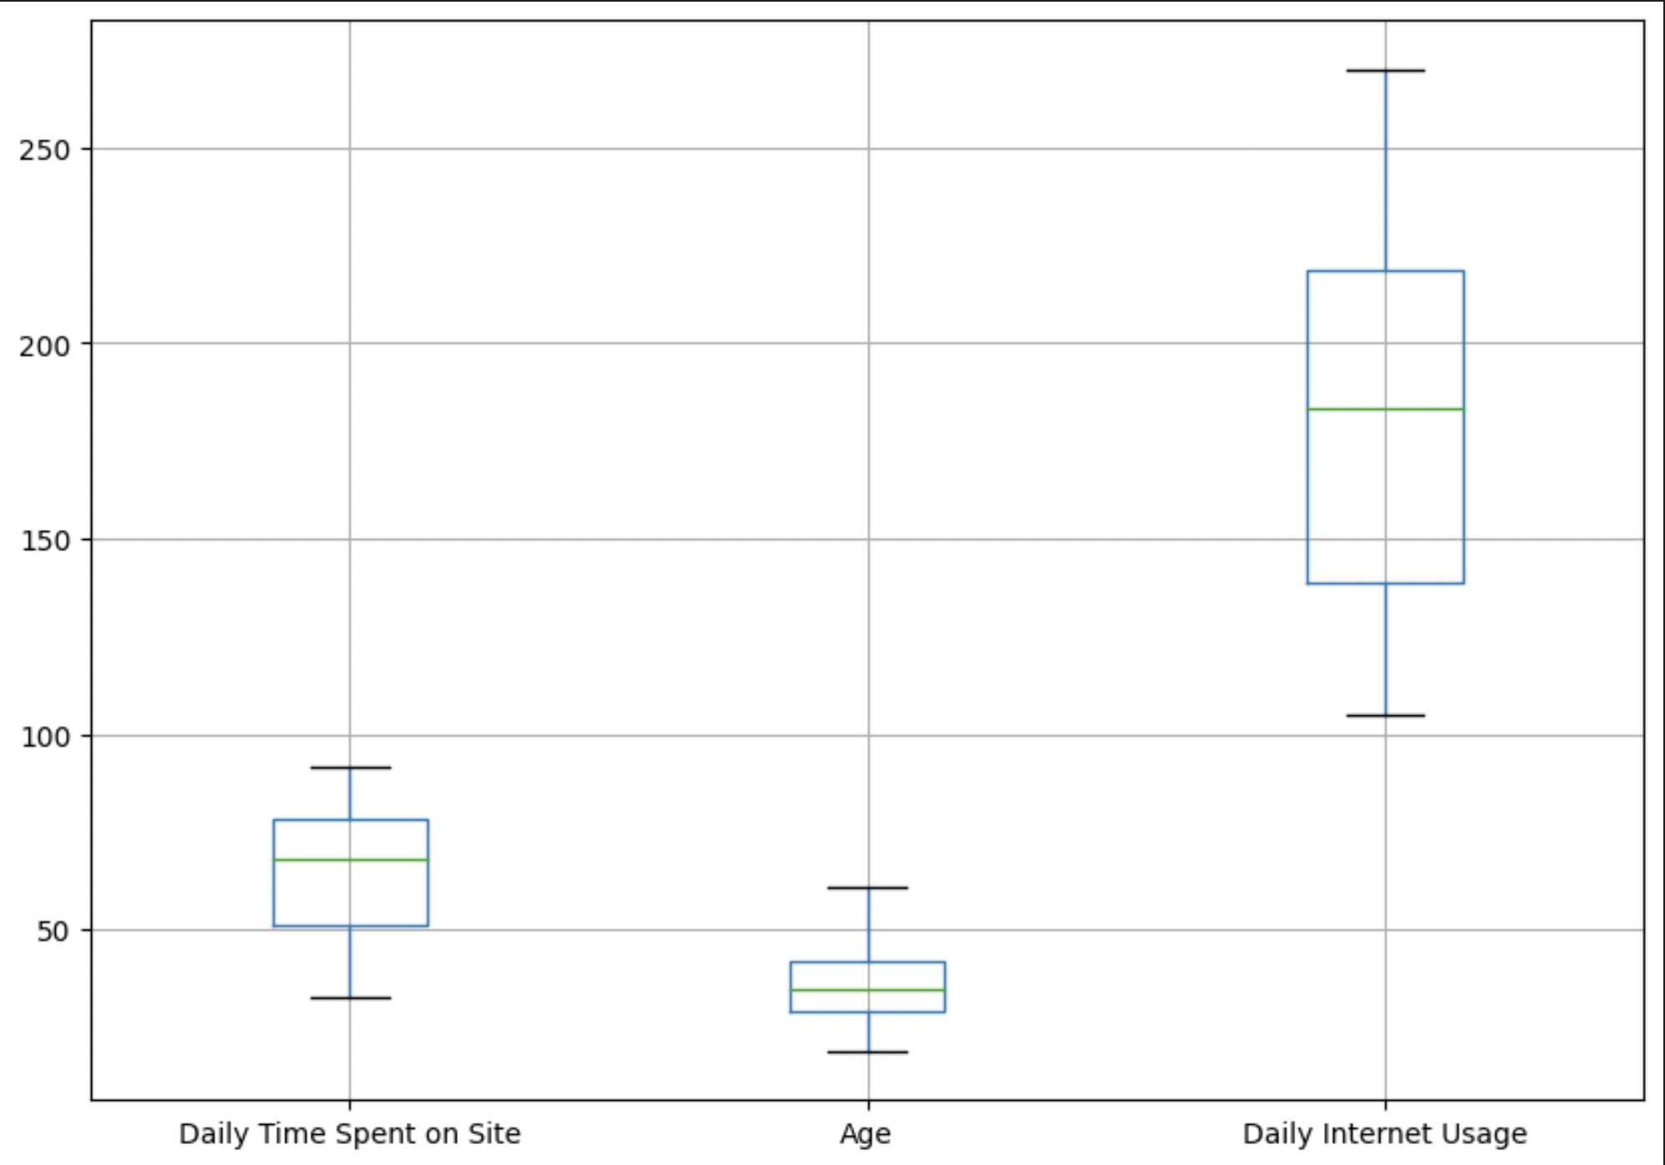
DATA VISUALISATION

Slide 7
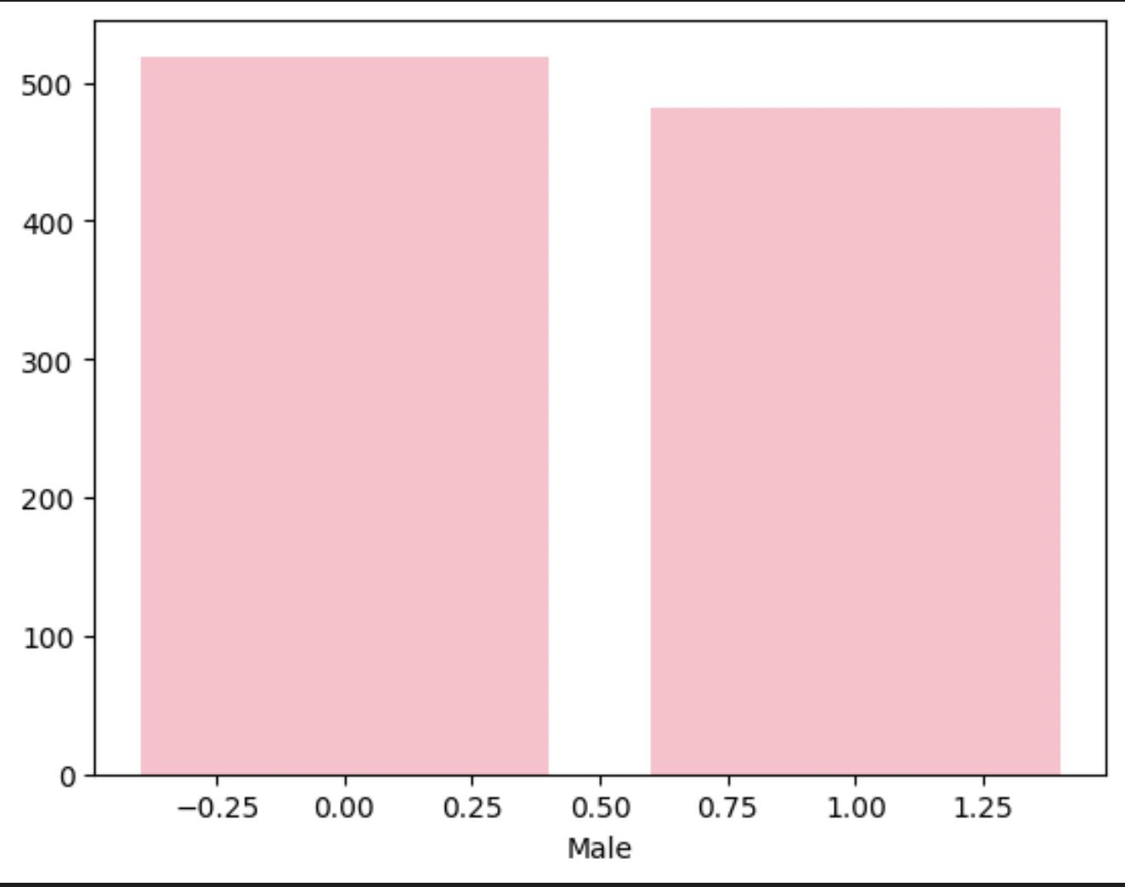
DATA VISUALISATION
BAR CHART
IT IS USED TO REPRESENT FREQUENCY OF VALUES IN A ATTRIBUTE , IF THE NUMBER OF UNIQUE VALUES ARE HIGHER , THE BAR CHART APPEARS TO BE CLUMSY , IT IS NOT AN OPTIMAL WAY OF ANALYSING SUCH KIND OF DATA
HERE WE ANALYSE MALE COLOUMN , WHERE 0 REPRESENTS ‘FEMALE’ AND 1 REPRESENTS ‘MALE’ USING THE BAR GRAPH

Slide 8
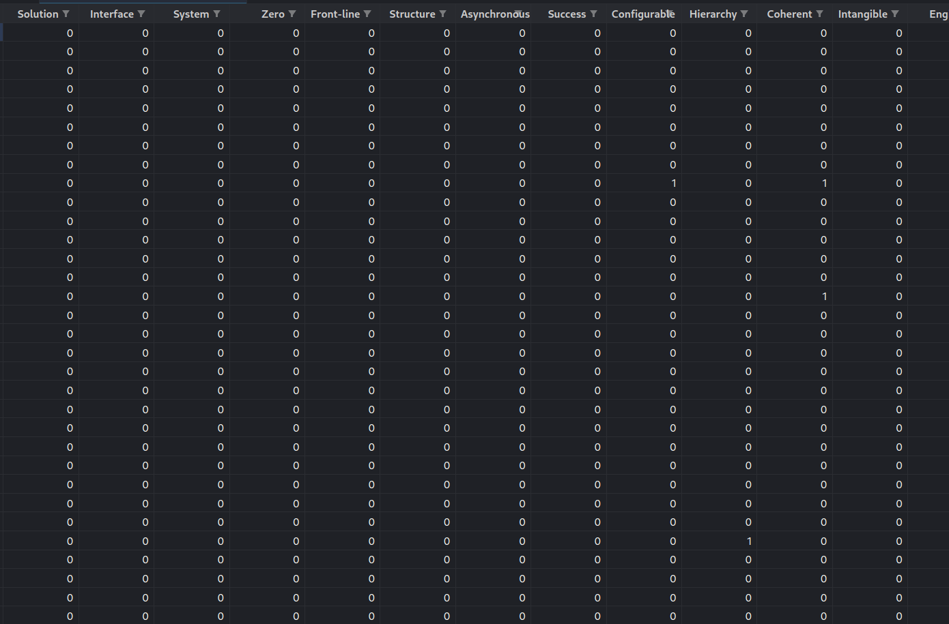
DATA PREPROCESSING
SOME ATTRIBUTES CONTAIN UNIQUE STRING VALUES , WHICH CAN’T BE CATEGORISED INTO CLASSES .
SO WE CLASSIFY THEM BY IDENTIFYING KEYWORDS AND TOKENS IN EACH ROW OF THE PARTICULAR ATTRIBUTE.
FOR EACH KEYWORD WE CREATE A COLUMN AND APPEND 0/1 WITH RESPECT TO THE PRESENCE OR ABSENCE OF THE PARTICULAR KEYWORD :- WE STORE IT AS A DATA FRAME.
FINALLY WE APPEND IT WITH THE ORIGINAL DATASET.
“AD TOPIC LINE” ATTRIBUTE IS PREPROCESSED IN SUCH A WAY.
THIS PROCESS IS CALLED AS “VECTORISATION”

Slide 9
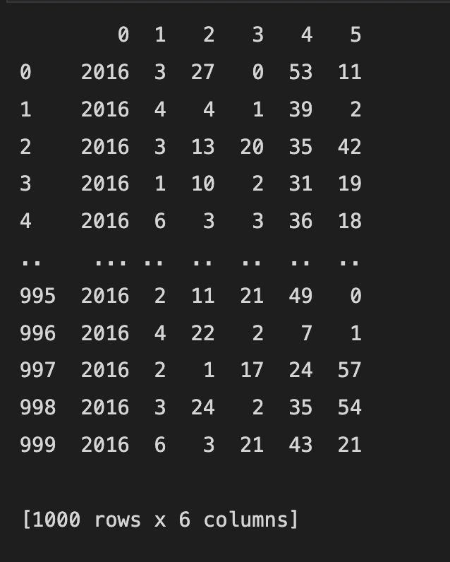
DATA PREPROCESSING
SIMILARLY “TIMESTAMP” ATTRIBUTE IS ALSO HAVING STRING VALUES, BUT A MODEL CAN BE BUILT USING NUMERICAL DATA ONLY .
HENCE WE CREATE NEW COLUMNS FOR YEAR , MONTH , DAY , HOURS , MINUTES AND SECONDS:- WE STORE IT AS A DATA FRAME.
THEN WE CONCATENATE THIS DATA FRAME WITH ORIGINAL DATASET.

Slide 10
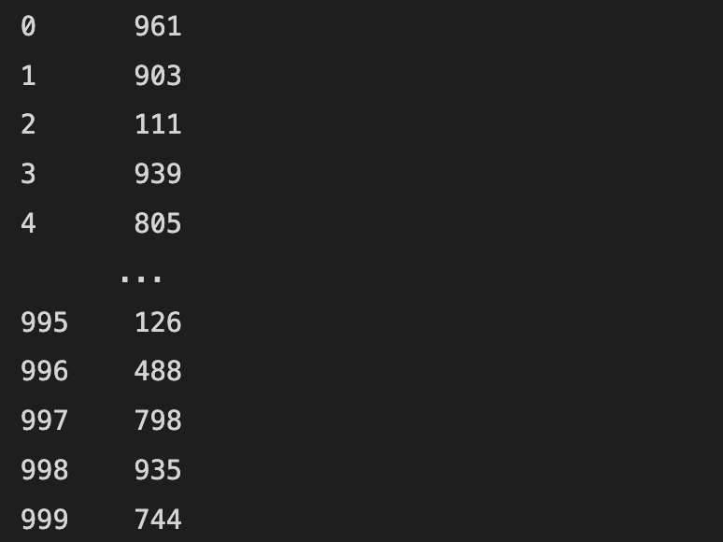
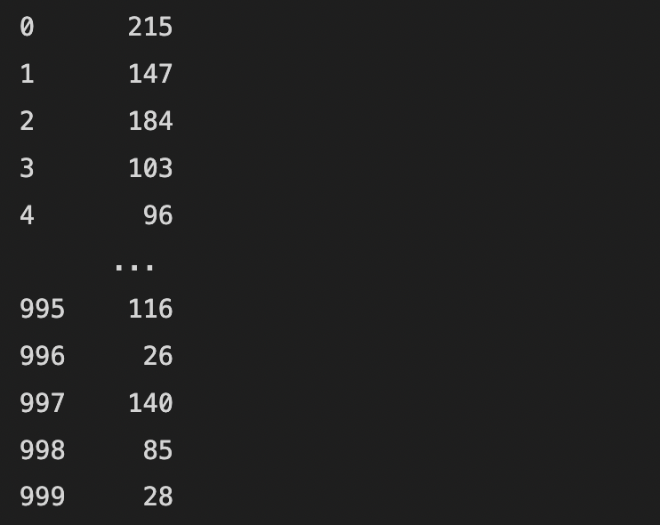
DATA PREPROCESSING
LABEL ENCODING
CONVERTING/ENCODING /MAPPING VALUES OF AN ATTRIBUTE TO NUMBERS IS CALLED AS LABEL ENCODING
WE HAVE DONE IT FOR TWO ATTRIBUTES NAMELY “CITY” AND “COUNTRY”

Slide 11
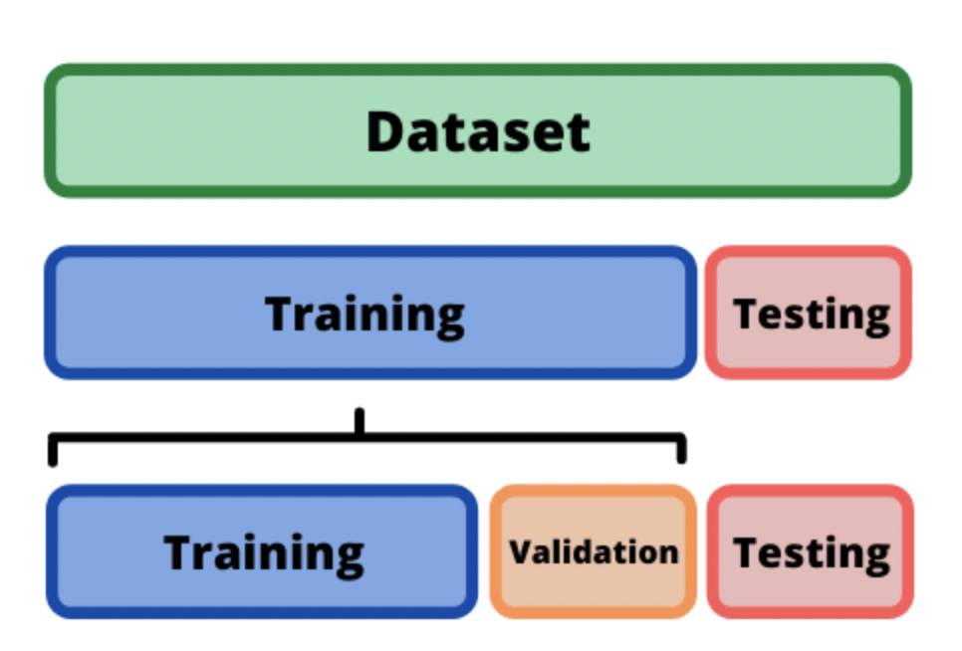
DATA SPLITTING AND MODEL CREATION
WE USUALLY SPLIT THE DATA SET INTO TRAINING DATASET AND TEST DATASET USING K FOLD METHOD OR PERCENTAGE SPLIT.
AFTER SPLITTING THE THE DATASET WE BUILD THE MODEL AND TRAIN IT.
AFTER THAT WE TEST THE MODEL WITH TEST DATASET , WHERE THE MODEL IS FROZEN AND PREDICTS OUTPUT FOR EVERY INPUT IN THE TEST DATASET.
IF ERRORS ARE LESS BETWEEN PREDICTED AND ACTUAL LABEL VALUE, THE ACCURACY OF PREDICTION IS HIGH.

Slide 12
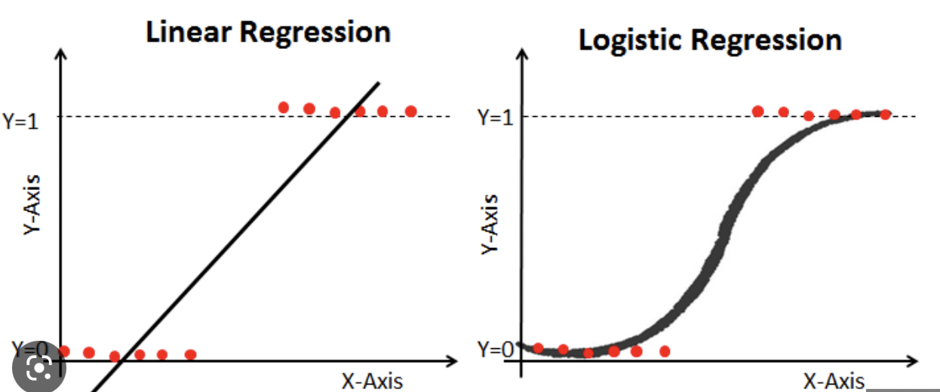
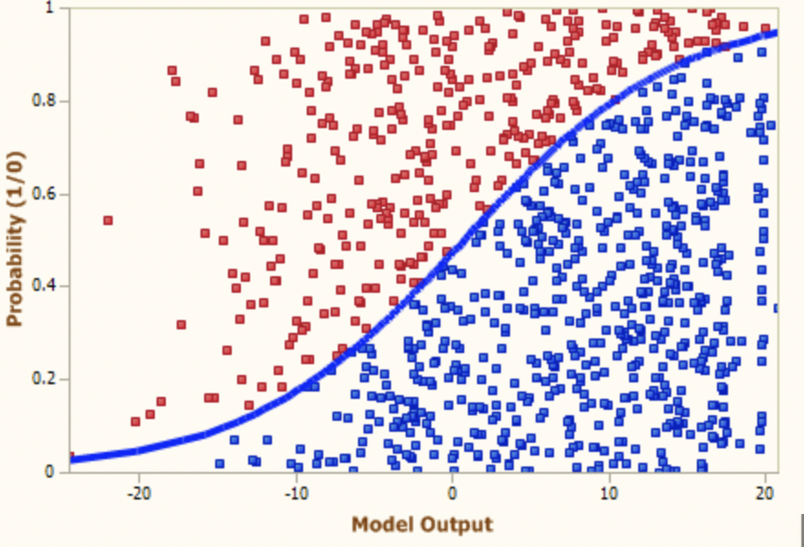
DATA SPLITTING AND MODEL CREATION
OUR PROBLEM IS JUST A BINARY CLASSIFICATION PROBLEM
BINARY DATA DOES NOT HAVE NORMAL DISTRIBUTION , LINEAR REGRESSION ONLY WORKS FOR NORMALLY DISTRIBUTED DATA.
LOGISTIC REGRESSION
WHEN GIVEN SET OF INDEPENDENT VARIABLES , MODEL EXPLAINS THE PROBABILITY OF ACCEPTANCE OR REJECTION DETERMINING WHETHER THE INPUT FALLS INTO A CATEGORY OR NOT.
ESTIMATES LINEAR COMBINATION OF INDEPENDENT VARIABLES AND USES INVERSE LOGIT FUNCTION TO DETERMINE PROBABILITY.
LOGIT^(-1)(ALPHA) = e^(ALPHA)/1 + e^(ALPHA)
ALPHA = B0 + B1X1 + …BNXN

Slide 13
ACCURACY OF PREDICTION
WHEN ACCURACY WAS CHECKED FOR THE BUILT MODEL, WE ENDED WITH A “96.666” PERCENTILE.
SO THERE CAN BE CHANCE FOR THE MODEL TO BE OVERFITTED THAT IS IT PERFORMS WELL IN TRAINING DATASET AND FLOPS IN THE PREDICTION CHANGE.
SO WE TOOK K-1 FOLDS AND FOUND ACCURACY FOR EACH FOLD , THEN AVERAGED IT OUT .
AS THE AVERAGE VALUE WAS APPROXIMATELY CLOSE TO THE ACTUAL VALUE OF ACCURACY THE MODEL IS NOT OVERFITTING.

Slide 14
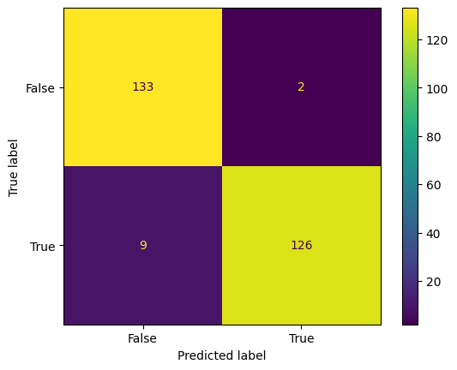
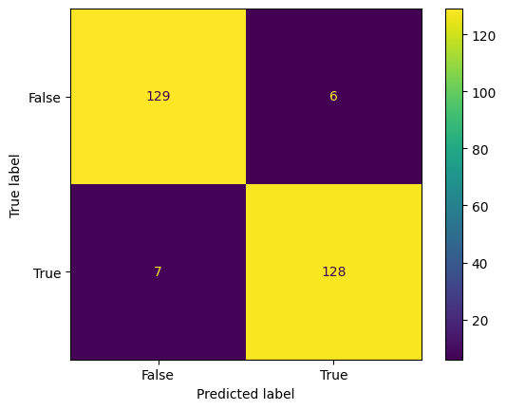
Confusion matrix
Logistic regression Desicion Trees

Slide 15
THANK YOU
TEAM MEMBERS:-

